Slide 1
CVS -THE BLOOD
PREPARED BY MCO KATO JOEL KYAMBADDE
FOR IPI MAYA
DCM

Slide 2


Slide 3
Blood is the liquid part of the CVS
It is a connective tissue
Contributes about 7-8% of the total blood volume.
PHYSICAL CHARACTERISTICS OF BLOOD
It is denser and more viscous (thicker) than water. It feels slightly sticky
It's temperature is about 38°C
Has a slightly alkaline pH, 7.35-7.45
It's color is bright red when rich in oxygen, and dark red when deoxygenated
Normal blood volume is 4-5liters in an average sized female, and 5-6liters in an average sized male.

Slide 4
FUNCTIONS OF BLOOD
Carries oxygen from the lungs to tissues, and Carbondioxide from the tissues to the lungs, for excretion.
Carries nutrients from the gastrointestinal tract to tissues, and cell wastes from tissues to excretory organs(mainly the kidneys)
Carries hormones excreted by endocrine glands to their target glands and tissues
Carries heat produced in active tissues to other less active tissues
Carries protective substances like antibodies to areas of infection.
Carries clotting factors that coagulate blood, minimising blood loss from raptured blood vessels.

Slide 5
COMPONENTS OF BLOOD
Blood plasma( 55%)
Formed elements (45%)
BLOOD PLASMA
It is straw colored
Plasma is made up of 91.5% water, and 8.5% solutes
Most of these solutes are proteins.
Some of the proteins in the blood are also found else where in the body.
However, other proteins are restricted to blood plasma and these are called plasma proteins(because they are found in blood plasma)
Examples of plasma proteins include:
albumin,
fibrinogen,
Globulins eg antibodies (immunoglobulins)

Slide 6
FORMED ELEMENTS
These include;
Red blood cells-99%
White blood cells(basophils, eosinophils, neutrophils, monocytes, lymphocytes etc)
Platelets.(thrombocytes)
The formed elements are formed by a process called haemopoiesis.
The process of blood formation is called haematopoiesis/ haemopoiesis.
Blood formation is stimulated by the hormone erythropoietin, which is produced by the kidneys.

Slide 7
Sites of haemopoiesis
In normal childhood and adult life, the red bone marrow is the only source of new blood cells
Fetus
0-2 months,----------yolk sac
2-7 months,----------liver and spleen
By 9months(birth)----------- bone marrow
Infants
Bone marrow of all bones

Slide 8
Adults
Vertebrae, sacrum, ribs, sternum, skull,pelvis, proximal ends of the femur and humerus.

Slide 9
Process of erythropoiesis
The whole process starts with a haematopoietic stem cell, in the bone marrow
The haematopoietic stem cell divides into two types of stem cells
Lymphoid stem cell
Myeloid stem cell

Slide 10
LYMPHOID STEM CELL
The lymphoid stem cell divides to form 4 different types of blood cells
B lymphocytes ( B cells)----- small lymphocyte
T lymphocytes ( T cells)------small lymphocyte
Natural killer cells (NK cells)---- large lymphocyte
Lympoid dendritic cell.

Slide 11
MYELOID STEM CELL
The myeloid stem cell divides progressively to form the following types of blood cells
Erythocytes( red blood cells)
Platelets
Basophils, eosinophils, neutrophils ( granulocytes)
Mast cells
Monocytes( develop into macrophages)

Slide 12
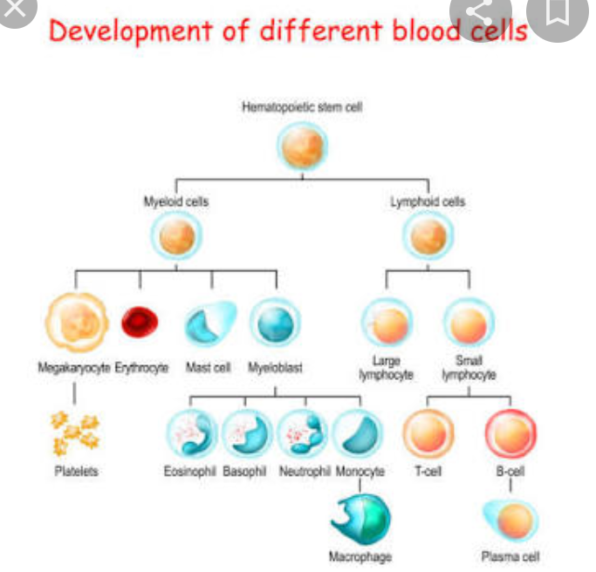

Slide 13
Having discussed the basic knowledge about blood, we shall now discuss the formed elements in more detail.

Slide 14
Red blood cells
These are biconcave disc shaped.
They have a strong and flexible membrane, which allows them to deform without rapturing as they squeeze through tiny blood capillaries.
They lack a nucleus. This means that they cannot repair themselves when damaged, and cannot carry out extensive metabolism
They lack mitochondria. - they generate ATP anaerobically, which means they don't use up any of the oxygen they transport.

Slide 15
Each RBC contains numerous molecules of hemoglobin ( oxygen carrying pigment in blood)
A hemoglobin molecule is made up of two parts,
heme ring and globin.
The globin part is made up of protein ie two alpha polypeptide chains and two beta polypeptide chains
The heme ring is a non protein pigment bound to each of the 4 polypeptide chains
There is an Fe2+ ion in the centre of each heme ring, onto which oxygen can bind.

Slide 16
WHITE BLOOD CELLS/LEUKOCYTES
These are the cells that protect the body against infectious agents.
Therefore WBCs participate in immunity.
Although WBCs are produced in the bone marrow , they are found throughout the body
They are also present in blood and in the lymphatic system
All WBCs have nuclei. Because of this, they are different from other blood cells ie the RBCs and platelets which lack nuclei.

Slide 17
There are two main types of WBCs
Granulocytes( granular leukocytes)
Agranulocytes( agranular leukocytes)
GRANULOCYTES/ granular leukocytes
These are WBCs whose cytoplasm contains granules. These granules contain chemical substances inside them.
There are 3 subtypes of granulocytes

Slide 18
Basophils
Eosinophils
Neutrophils
Of these, neutrophils are the most abundant,while basophils are the least abundant
The granules inside the cytoplasm of granulocytes stain with different colours, when stained in the laboratory.
Eosinophils take up the red acid dye, eosin hence their name
Basophils take up the basic dye called methylene blue, which is blue in color. Hence their name
Neutrophils take up both dyes (eosin and methylene blue) and stain pink. Hence they are neutral ie neither acidic nor basic.

Slide 19
NEUTROPHILS
These are the most abundant of all granulocytes
Their shape is spherical when floating in blood, but when they are actively engulfing pathogens, they become irregular shaped.
The cytoplasm of a neutrophil contains numerous small granules which stain pink with Wright's stain.
They have a nucleus which is made up of 3-5 lobes. Therefore their nucleus is multilobed.

Slide 20
The lobes are connected to each other by thin strands of chromatin
Function of neutrophils
To protect the body against foreign material that enters the body especially bacteria and fungi
They also remove cellular debris ( products of cellular break down)
When microorganisms eg bacteria, fungi enter our body, the damaged cells produce substances which attract neutrophils to this site. Neutrophils then move out of blood capillaries into affected tissues where they phagocytose (engulf and destroy) the microorganisms.

Slide 21
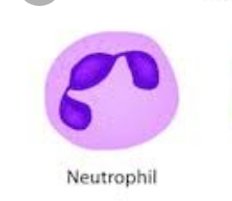
Neutrophil

Slide 22
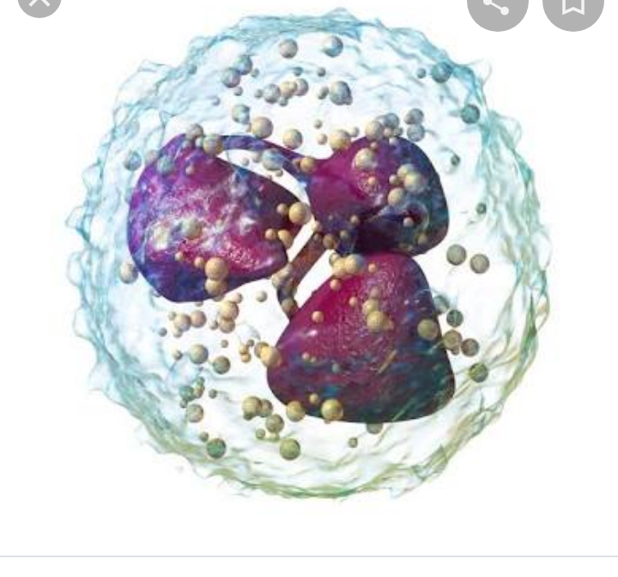

Slide 23
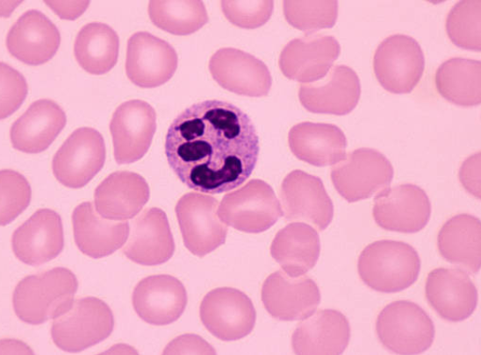

Slide 24
Basophils and Mast cells
They are called basophils because they take up the basic dye methylene blue in Wright's stain, such that their cytoplasm stains blue
The cytoplasm contains numerous large granules which stain blue
They are also spherical in shape
They have a bilobed nucleus (nucleus has two lobes) connected by a thin strand of chromatin
Basophils are the least abundant type of WBCs

Slide 25
Function of Basophils
They protect the body against helminths
NB: structurally, mast cells and Basophils are similar. The difference is their location. Mast cells are located in extravascular tissues, while Basophils are found in blood.

Slide 26
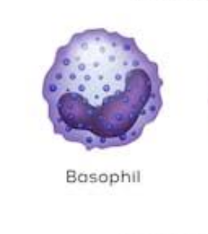
Basophil

Slide 27
EOSINOPHILS
Very few
Called eosinophils because they take up the acidic red dye eosin in Wright's stain, and they stain red.
They are also spherical in shape.
The nucleus has 2-4 lobes. Usually bilobed.
The cytoplasm contains numerous granules.

Slide 28
Functions of eosinophils
Protection against helminths/Nematodes
Play a role in allergic reactions.

Slide 29
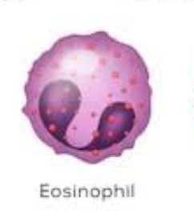
Eosinophil

Slide 30
NON GRANULAR LEUKOCYTES/ AGRANULOCYTES/ MONONUCLEAR LEUKOCYTES
These are white blood cells which
Don't have granules in their cytoplasm
Have a large nucleus
They are of two types
Monocytes and macrophages
Lymphocytes
They make up 25-50% of all leukocytes.

Slide 31
MONOCYTES
Have a single large nucleus
The nucleus is kidney shaped.
They remain in blood , phagocytosing microbes that they encounter/meet.
When monocytes leave blood, they turn / develop into macrophages.

Slide 32
Functions of macrophages
Phagocytosis of microbes
Remove cellular debris
Phagocytosis of worn out neutrophils.

Slide 33
THE MONOCYTE-MACROPHAGE SYSTEM
Also called the reticulo endothelial system (RES)
This consists of monocytes and macrophages
When monocytes leave blood vessels, they develop into a type of macrophages called wandering macrophages.
These wandering macrophages move about in tissues , carrying out phagocytosis
However some macrophages are fixed in particular sites and they are called fixed macrophages

Slide 34
The sites with fixed macrophages are discussed below
Histiocytes in connective tissue
Microglia in the brain
Kupffer cells in the liver
Alveolar macrophages in the lungs
Osteoclasts in bone
Mesangial cells in the glomerulus of the nephron
Sinus lining macrophages (reticular cells) in the spleen, lymph nodes, and thymus gland

Slide 35
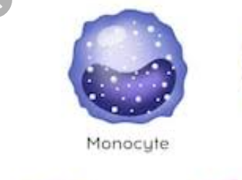
Monocyte

Slide 36
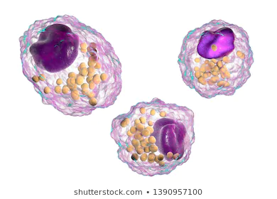
MACROPHAGES

Slide 37
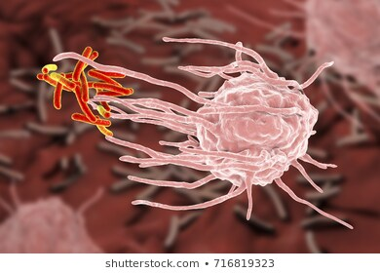
Macrophage in action

Slide 38
LYMPHOCYTES
They are smaller than monocytes
They have a large nucleus, less cytoplasm
They circulate in blood but are present in large numbers in lymphatic tissue
There are three (3) types of lymphocytes
B lymphocytes
Tlymphocytes
Natural killer lymphocytes(NK cells)

Slide 39
Functions of lymphocytes
They produce antibodies ( b cells)
They destroy infected cells thereby preventing spread of infection.(NK and t lymphocytes)

Slide 40
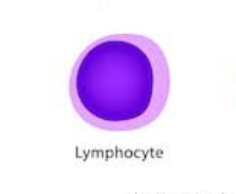
Lymphocyte

Slide 41
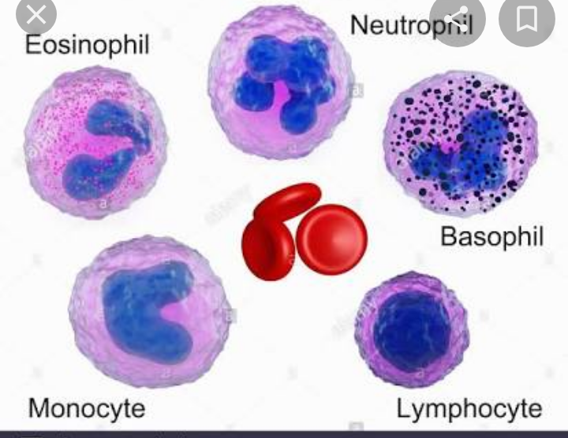

Slide 42
PLATELETS(THROMBOCYTES)
Platelets are very small blood cells
They are very tiny fragments formed from megakaryocytes.
A platelet has a plasma membrane BUT lacks a nucleus
Has tiny granules in the cytoplasm
They are derived from the cytoplasm of megakaryocytes.

Slide 43
FUNCTIONS OF PLATELETS
Blood clotting/ Hemostasis
NOTE THE DIFFERENCE BETWEEN HAEMOSTASIS AND HOMEOSTASIS

Slide 44
HAEMOSTATIS/HEMOSTASIS
Hemostasis means to prevent blood from moving out of blood vessels.
When a blood vessel is damaged, Hemostasis occurs to prevent blood from moving out of the damaged blood vessel.
There are many stages involved in this process of Hemostasis.
Let's first define one very important term which is commonly used in Hemostasis but some students find difficult to understand.

Slide 45
Term: coagulation
Coagulation is the conversion of soluble fibrinogen(in blood plasma) into insoluble fibrin.
Coagulation is a property of blood plasma
Fibrinogen is a soluble plasma protein which is produced by the liver.
The term coagulation must be understood very well.
In the later sections of this module, it will be clear that coagulation is not the same as Hemostasis.
Rather, coagulation is just a part of Hemostasis.

Slide 46
HOW DO BLOOD VESSELS KEEP BLOOD IN A LIQUID FORM?
Blood is kept in a liquid form within blood vessels, but when a blood vessel is injured, it forms a semi solid in that area.
This means that there is a mechanism(s) by which blood vessels keep blood in a liquid form.
We'll start off with some anatomy of blood vessels.
A blood vessel wall typically has three layers,which from inside outwards are the tunica intima/ interna, tunica media and tunica adventitia/externa.

Slide 47
Tunica interna is the inner most layer and is in direct contact with blood
It is also called tunica intima
It is made up of a single layer of simple squamous epithelium called endothelium.
Tunica media is the middle layer
It lies in-between the tunica interna and the tunica externa
It is made up mainly of smooth muscles fibres and elastic connective tissue.

Slide 48
Smooth muscle fibres regulate the diameter of the blood vessel. When they contract, the diameter of the blood vessel decreases and when they relax the diameter of the blood vessel increases
The elastic connective tissue provides structural support to the blood vessel. It enables the blood vessel to stretch when it receives more blood, without rapturing.

Slide 49
The outer most layer is called Tunica externa/ tunica adventitia
It is made up of elastic and collagen fibres
This also provides structural support to the blood vessel.
That is the basic structure of all blood vessels.

Slide 50
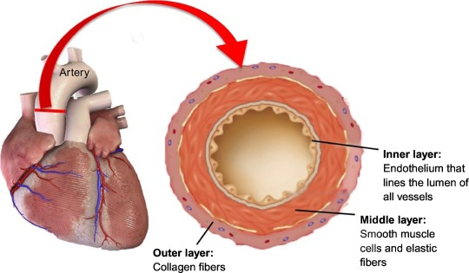

Slide 51
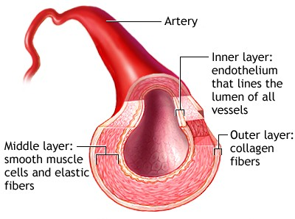

Slide 52
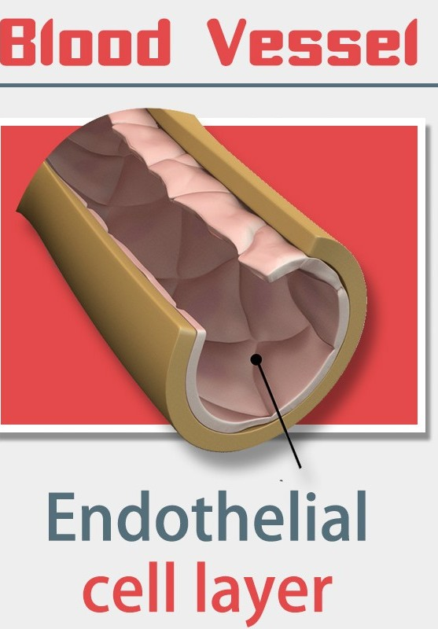

Slide 53
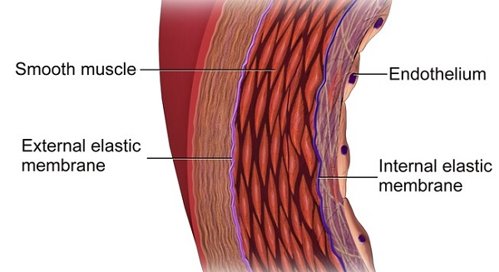

Slide 54
The endothelial cells play a very important role in preventing blood from coagulating
This, when the endothelium is damaged, changes occur tha result in coagulation.
1. Endothelial cells produce produce the following substances;
Nitric oxide
Prostaglandin I2 / Prostacyclin
ADP dephosphatase

Slide 55
NO and Prostacyclin prevent platelet adhesion and aggregation. (Antiplatelets). NO also induces platelet disaggregation.
ADP dephosphatase removes a phosphate group from ADP( converts ADP to AMP).
ADP activates platelets and enhances their aggregation onto the endothelium.

Slide 56
2. Healthy endothelial cells also prevent accumulation of activated coagulation factors near them.
A. All healthy endothelial cells have receptors called heparin sulphate on which antithrombin III binds. This activates antithrombin III, which destroys thrombin molecules that come in contact with healthy endothelial cells.( Thrombin helps in the coagulation cascade)

Slide 57
Antithrombin III also inactivates clotting factors IX and X.
B Healthy endothelial cells also express molecules called thrombomodulin. Thrombomodulin binds thrombin and alters(modulates) it's action. Thrombin activates Protein C, which inactivates factor V and factor VIII.

Slide 58
C. Healthy endothelial cells also produce tissue plasminogen activator which activates plasminogen to plasmin. Plasmin breaks fibrin preventing blood coagulation.
All these 4 mechanisms keep blood in a liquid form. Hence healthy endothelium is both antiplatelet and anticoagulant.
However, when the endothelium is damaged, these mechanisms are disturbed and platelets aggregate, and blood coagulation also occurs.

Slide 59
Clotting factors
These are proteins synthesized in the liver( most of them by hepatocytes), which participate in.blood coagulation ie conversion of soluble fibrinogen to fibrin.
Von Willebrand factor(VWF) is synthesized by endothelial cells that line blood vessels.

Slide 60
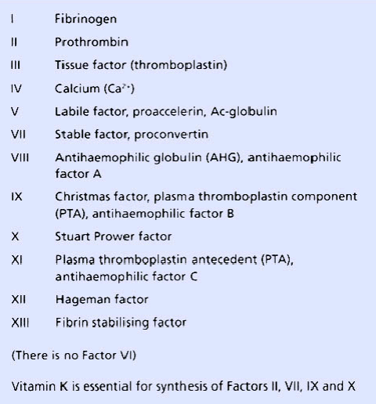

Slide 61
The following stages occur during hemostasis
Vasoconstriction
Platelet adhesion
Platelet activation and aggregation
Coagulation( blood clotting)
NB: haemostasis begins immediately after blood vessel injury.

Slide 62
ROLE OF VITAMIN K IN COAGULATION
Vitamin K converts some procoagulating factors into active coagulating factors
Coagulating factors II, VII, IX and X are glycoproteins which contain gamma carboxyglutamic acid. This is formed by carboxylation of a glutamate residue in the peptide chain of the precursor. To do this, the recycling of vitamin K between epoxide, quinone and hydroquinone forms is essential.
An enzyme called Quinone reductase reduces vitamin K Quinone(dietary form) into vitamin K hydroquinone.
Vitamin K hydroquinone donates electrons to the enzyme gamma glutamylcarboxylase.

Slide 63
Then gamma glutamyl carboxylase is able to convert non functional forms of clotting factors II, VII, IX and X into functional forms
This occurs by addition of CH2O group to glutamic acid residues to the procoagulants
After donating electrons, Vitamin K hydroquinone is converted to vitamin K epoxide.
Vitamin K epoxide is converted by the enzyme epoxide reductase back into vitamin K Quinone, such that it can be used again.

Slide 64
1 VASOCONSTRICTION
It is the first response to damage of the endothelium a of blood vessel
The affected blood vessel constricts
Vasonstriction reduces the amount of blood flowing to the affected vessel.
This minimises blood loss from the damaged blood vessel.

Slide 65
Vasoconstriction occurs via the following mechanisms;
Neurogenic reflex vasoconstriction - Damaged local nerve cells release vasoactive substances
Myogenic vasoconstriction- Damaged smooth muscle cells also initiate vasoconstriction.They contract.
Damaged endothelial cells- Also release a vasoconstrictor called endothelin, which acts on the smooth muscles of the blood vessel causing vasoconstriction.

Slide 66
2. PLATELET ADHESION
When the endothelium ( inner most layer of a blood vessel wall) is damaged, it loses its antiplatelet and anticoagulant properties.
Damaged endothelial cells release Von willebrand factor(VWF) onto the exposed basement membrane.
VWF makes the basement membrane very sticky to platelets.
Platelets have glycoprotein Ib(GpIb) receptors that stick onto injured endothelium and basement membrane.
Therefore platelets in the surrounding blood stick onto the injured endothelium
This is called platelet adhesion
NB; Adhesion simply means two different things sticking into each other. So in this case platelets stick(adhere) to the endothelium.

Slide 67
3 PLATELET ACTIVATION AND AGGREGATION
Following platelet adhesion, platelets become activated and they produce the following substances
Thromboxane A2 - Thromboxane A2 and ADP attract other platelets to the area.
Activated platelets also release two types of granules;
(A). Dense granules which contain ;
Serotonin - vasoconstriction
ADP - activates platelets and enhances their aggregation
Calcium ions(Ca2+)- coagulation.

Slide 68
(B) Alpha granules which contain;
Coagulation factors especially V and VII
Fibrinogen
Platelet derived growth factor
3 and 4 are called primary platelet plug formation.

Slide 69
The result is more platelets come and stick onto the first layer of platelets that was already present.
Thus is called platelet aggregation ie platelets aggregate to form several layers of platelets piled on top of each other.
At this stage, these layers of platelets form the primary hemostatic plug/ primary platelet plug. This prevents blood from flowing out but it's too weak, and blood may flow out soon.

Slide 70
Difference between platelet adhesion and platelet aggregation
Platelet adhesion involves platelets attaching onto damaged endothelium WHILE platelet aggregation involves more Platelets attaching onto the layer of platelets which is already adherent on the damaged endothelium.

Slide 71
4 COAGULATION.
Recall; coagulation means conversion of soluble fibrinogen to insoluble fibrin
Assignment
Make notes about clotting factors from anatomy and physiology by Ross and Wilson.

Slide 72
Coagulation occurs via 2 pathways
Intrinsic pathway
Extrinsic pathway
INTRINSIC PATHWAY
This pathway is switched on when blood comes in contact with activated platelets
When clotting factor XII /Hageman factor/contact factor comes in contact with activated platelets, it becomes activated.

Slide 73
Activated factor XII, also activates clotting factor XI
In the presence of Ca2+, activated factor XI activates clotting factor IX
Activated factor IX, activates clotting factor X. However , the activation of clotting factor X requires the presence of calcium ions(clotting factor IV) , factor VIII and phospholipids. Phospholipids come from damaged endothelial cells and platelets.
In the presence of Ca2+, factor V and phospholipids, activated clotting factor X then acts on prothrombin (factor II), converting it into thrombin.
Thrombin then converts fibrinogen into fibrin.

Slide 74
Thus fibrin is deposited onto the primary platelet plug.
Thrombin also activates fibrin stabilising factor (factor XIII) which cross links the fibrin monomers, forming a secondary hemostatic plug.
The secondary hemostatic plug is more stable than the primary hemostatic plug and is securely attached to the blood vessel wall.
Intrinsic pathway is initiated in 2-6 minutes

Slide 75
EXTRINSIC PATHWAY
This is initiated by tissue factor/factor III/ Thromboplastin
Thromboplastin is an integral transmembrane protein expressed by cells in the adventitia of blood vessels (astroglial cells). It serves as a receptor for clotting factor VII/VIIa.
Normally, the vascular endothelium acts as a physical barrier between blood and the adventitia, and so prevents factor VII/VIIa from binding to tissue factor.

Slide 76
When a penetrating blood vessel injury occurs, extravascular tissue factor enters the blood plasma, allowing factor VII to bind to it.
When factor VII binds to tissue factor, it becomes activated and initiates the extrinsic pathway(also called the tissue factor pathway)

Slide 77
This clotting factor III activates clotting factor VII
Activated factor VII can do two things
Activates factor IX
Directly Activates factor X, in the presence of Ca2+
Then the rest of the steps in this pathway proceed as in the intrinsic pathway.
NB: Extrinsic pathway is way faster than intrinsic pathway.
Extrinsic pathway is initiated within 15-20seconds

Slide 78
NB: vitamin K is essential for the synthesis of clotting factors II, VII, IX, X.
Hence vitamin K is essential for blood clotting.
Once blood vessel repair is underway, the fibrinolytic or thrombolytic system dissolves the clot.
Tissue plasminogen activator (tPA) activates plasminogen to plasmin which digests fibrin.

Slide 79
PROTHROMBIN TIME TEST
A patient's blood sample is obtained by venipuncture.
Blood is decalcified by collecting it into a tube with oxalate or citrate ions to prevent the clotting process from starting before the test begins
Blood is centrifuged to separate blood plasma from the formed elements
A source of tissue factor is added to the plasma( eg a protein, Thromboplastin from homogenised brain tissue).

Slide 80
The mixture is kept in a water bath at 37°C , and calcium chloride is added(source of calcium ions) to the mixture.
The test is timed from the addition of calcium chloride until blood plasma clots.
This time is called the prothrombin time(PT)
This test specifically indicates the presence of factors VII, V,X, prothrombin and fibrinogen. It evaluates the extrinsic and common pathways

Slide 81
A prolonged prothrombin time indicates a deficiency in any of factors VII, X, V, prothrombin, or fibrinogen.
It may mean that the patient has a vitamin K deficiency (vitamin K is a co-factor in the synthesis of functional factors II (prothrombin), VII, IX and X) or a liver disease (the liver is the site of synthesis of the plasma protein factors).
Normal PT is 11-15 seconds

Slide 82
The prothrombin time of patients receiving a vitamin K-competing coumarin drug such as warfarin (anticoagulation therapy used in deep venous thrombophlebitis) will also be prolonged, usually in the range of one and one half to two times the normal PT time

Slide 83
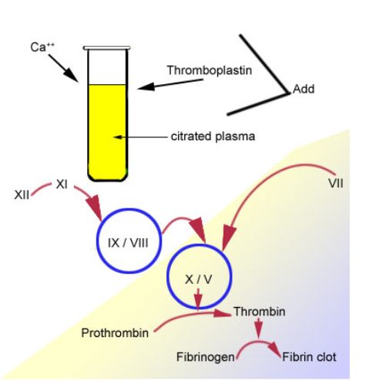

Slide 84
ACTIVATED PARTIAL THROMBOPLASTIN TIME (aPTT)
The activated partial thromboplastin time (aPTT) is a test performed to investigate bleeding disorders and to monitor patients taking an anticlotting drug such as heparin which inhibits factors X and thrombin, while activating anti-thrombin.

Slide 85
The aPTT test uses blood which is decalcified to prevent clotting before the test begins.
The plasma is separated by centrifugation. (Ionized) Calcium and activating substances are added to the plasma to start the intrinsic pathway of the coagulation cascade.

Slide 86
The substances are: kaolin (hydrated aluminum silicate) and cephalin. Kaolin serves to activate the contact-dependent Factor XII, and cephalin substitutes for platelet phospholipids.
The partial thromboplastin time is the time it takes for a clot to form, measured in seconds. Normally, the sample will clot in 35 seconds.
aPTT measures the intrinsic and common pathways

Slide 87
